Slide 1
Activation method of smart phone alarm on attempt to open door or windows wireless Artificial Intelligence IoT Solutions for Health and Wellness by: Dr. Nissim Zur www.TelnT.com nissim@telnt.com

Slide 2
The problem with “OLD” alarm systems today
TelnT’s alarm invention Solution
Home and office alarm systems are based on call center service company that charges monthly fees.
Room alarm systems send an alarm when the intruder is already in the house and may exit before police arrives.
Alarm sensor in the room is based on Infra-Red, PIR body "heat" movement, sends a lot of false alarm due to sun heat and pets movement.
Cost of installation per alarm device node is high.
Cost of alarm devices is high
Needs to install central alarm box.
Some alarms need an excavation in the walls to pass alarm wires.
No alert is generated on attempt to intrude the house.
No self-insulation by end user.
No immediate end user alert.
Smart House Internet of Things(“IoT”) device.
No call center service company needed.
The Alarm has Artificial Intelligence detects any attempt to enter from windows and doors. Calling police or activate sound alarm can be done before intruder enters inside the house.
The Alarm sensor is installed on windows and doors. Based on Smart Artificial Intelligence 3D movement detection. No false alarm. No heat detection.
Cost of installation per alarm device node is very low. 1.5 USD cost of production.
No need to install central alarm box.
Alarm based only on wireless Wi-Fi + Bluetooth low energy (BLE). NO need to make excavation in the walls
Alert is generated and sent to user’s smart phone on attempt to intrude the house
20 sec installation by end user. Just pill sticker cover and attach to any door and windows.
Immediate alert to end user’s smart phone.
The problem
Technologies
The Solution
Notes:
2

Slide 3
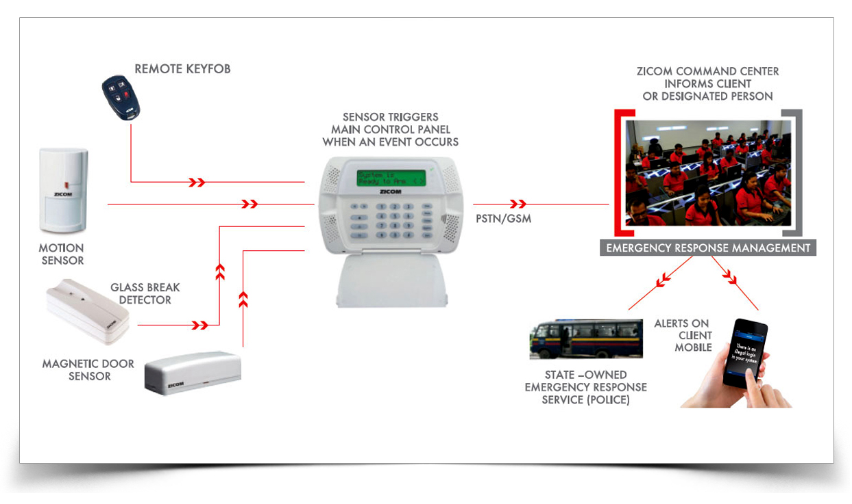
Old alarm system architecture
Notes:
3

Slide 4
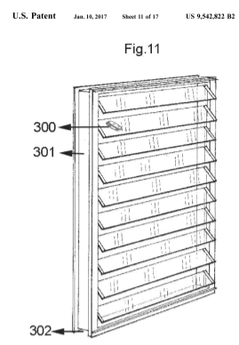
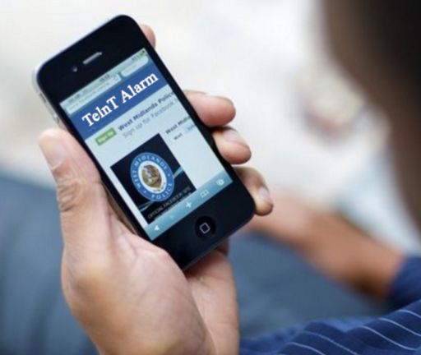
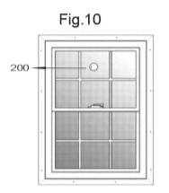
Method to activate smart phone alarm on attempt to open door or windows. See patent
TelnT’s alarm device
events
Commands
events
Commands
TelnT’s alarm device detects proximity to the end user phone to automatically active / deactivate the alarm.
The alarm device can also send events on temperature changes as in case of fire.
Notes:
4

Slide 5
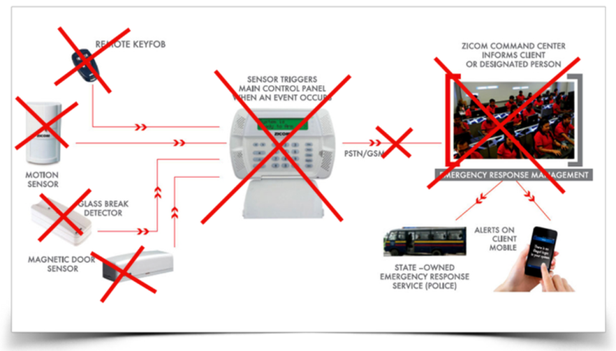
Method of activating smart phone alarm on case of an attempt to open door or windows. See patent
TelnT Alarm system Eliminates the need of all of the old alarm system units.
TelnT Alarm system can be attached to any object, not just to doors and windows.
It’s unique Artificial Intelligence algorithm will become a base for future alarm system in Smart Homes.
Notes:
5

Slide 6
TelnT CEO: Dr. Nissim Zur nissim@TelnT.com TEL: +972-54-4500635 (Israel)
TelnT focuses on unique owned Artificial Intelligence algorithms patented
Potentially able to replace old alarm system.
Cost 1.5 USD per unit, 10 sec installation.
Zero competitors on the TelnT alarm device so far (20-6-2017).
11 patents, of which 2 were granted already.
Company value 100M USD, looking for 15M USD investment for expansion and world wide marketing
www.TelnT.com nissim@telnt.com
Skype: nissim.test

